Slide 1
Advanced Web programming
Lec-10
Web Form Fundamentals

Slide 2
Outline
Web Form Fundamentals

Slide 3
Using Page Class
Every web page is a custom class that inherits from System.Web.UI.Page.
Many of the Page properties provide complete objects. For example, the Page.Response property allows you to access the Response object anywhere in your page, and the Page.Server property allows you to access the Server object.
First, you can use the Response and Server objects to send the user from one page to another, which is a key part of any ASP.NET application.
Second, you can use the Server object to encode text that may contain special characters so it can be inserted into web page HTML.

Slide 4
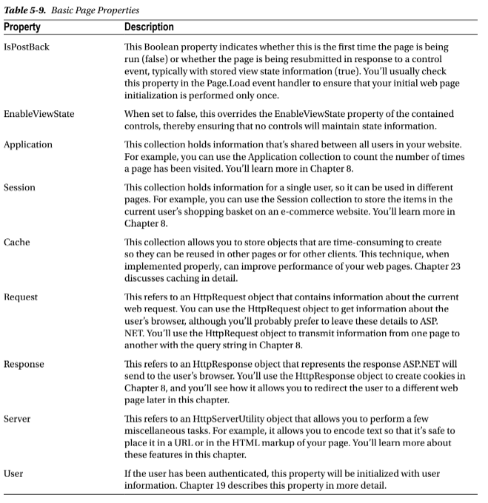

Slide 5
Sending the User to a New Page
One of the simplest is to use an ordinary<a>anchor element, which turns a portion of text into a hyperlink. In this example, the word here is a link to another page:
Click <a href="newpage.aspx">here</a> to go to newpage.aspx.
Response.Redirect("newpage.aspx");
When you use the Redirect() method, ASP.NET immediately stops processing the page and sends a redirect message back to the browser. Any code that occurs after the Redirect() call won’t be executed. When the browser receives the redirect message, it sends a request for the new page.
Server.Transfer("newpage.aspx");
The advantage of using the Transfer() method is that it doesn’t involve the browser. Instead of sending a redirect message back to the browser, ASP.NET simply starts processing the new page as though the user had originally requested that page. This behavior saves a bit of time, but it also introduces some significant limitations. You can’t use Transfer() to send the user to another website or to a non-ASP.NET page.

Slide 6
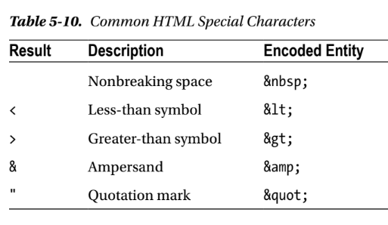
Working with HTML Encoding
You can use the HttpServerUtility.HtmlEncode() method to replace the special characters.
Here’s an example:
// Will output as "Enter a word &lt;here&gt;" in the HTML file, but the browser will display it as "Enter a word<here>".
ctrl.InnerHtml=Server.HtmlEncode("Enter a word<here>");

Slide 7
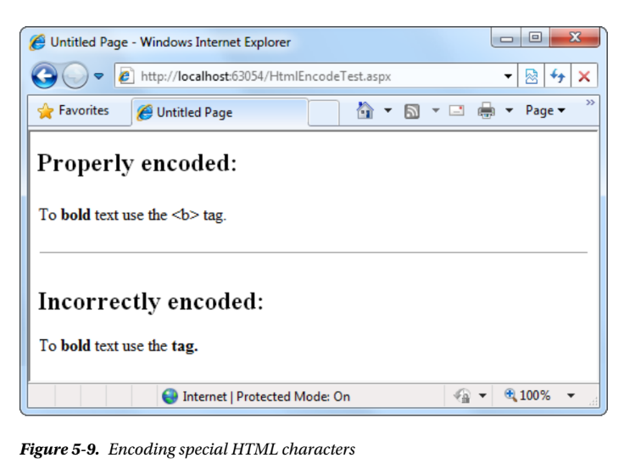
Or consider this example, which mingles real HTML tags with text that needs to be encoded:
ctrl.InnerHtml="To<b>bold</b>text use the ";
ctrl.InnerHtml+= Server.HtmlEncode("<b>")+" tag.";

Slide 8
Using Application Events
For example, by using application events, you can write logging code that runs every time a request is received, no matter what page is being requested.
You can’t handle application events in the code-behind for a web form. Instead, you need the help of another ingredient: the global.asax file.
The global.asax File
The global.asax file allows you to write code that responds to global application events. These events fire at various points during the lifetime of a web application, including when the application domain is first created.
The global.asax file looks similar to a normal .aspx file, except that it can’t contain any HTML or ASP.NET tags. Instead, it contains event handlers that respond to application events.

Slide 9
For example, the following global.asax file reacts to the EndRequest event, which happens just before the page is sent to the user:
<%@ Application Language="C#" %>
<script language ="c#" runat= "server">
protected void Application_EndRequest(object sender, EventArgs e)
{
Response.Write("<hr />This page was served at " +
DateTime.Now.ToString());
}
</script>

Slide 10
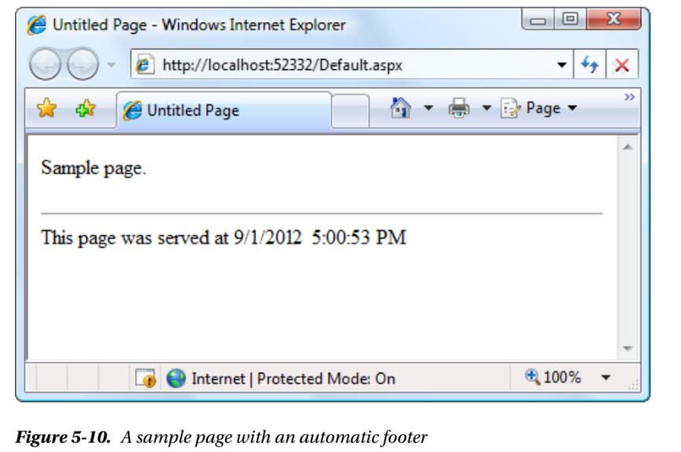

Slide 11
Each ASP.NET application can have one global.asax file.
After you place it in the appropriate website directory, ASP.NET recognizes it and uses it automatically.
For example, if you add the global.asax file shown previously to a web application, every web page in that application will include a footer.

Slide 12
Configuring an ASP.NET Application
Every web application includes a web.config file that configures fundamental settings—everything from the way error messages are shown to the security settings that lock out unwanted visitors.
The ASP.NET configuration files have several key advantages:
They are never locked: You can update web.config settings at any point, even while your application is running. If there are any requests currently under way, they’ll continue to use the old settings, while new requests will get the changed settings right away.
They are easily accessed and replicated: Provided you have the appropriate network rights, you can change a web.config file from a remote computer. You can also copy the web.config file and use it to apply identical settings to another application or another web server that runs the same application in a web farm scenario.
The settings are easy to edit and understand: The settings in the web.config file are human-readable, which means they can be edited and understood without needing a special configuration tool.

Slide 13
Working with the web.config File
The <appSettings> section allows you to add your own miscellaneous pieces of information.
The <connectionStrings> section allows you to define the connection information for accessing a database.
Inside the <system.web> element are separate elements for each aspect of website configuration. You can include as few or as many of these as you want. For example, if you want to control how ASP.NET’s security works, you’d add the <authentication> and <authorization> sections.
Most important is the<compilation>element, which uses two key attributes to specify two key details:
debug: This attribute tells ASP.NET whether to compile the application in debug mode so you can use Visual Studio’s debugging tools.
targetFramework: This attribute tells Visual Studio what version of .NET you’re planning to use on your web server

Slide 14
Assembly
An Assembly is a basic building block of . Net Framework applications.
It is basically compiled code that can be executed by the CLR.
An assembly is a collection of types and resources that are built to work together and form a logical unit of functionality.
Assembly Class
An assembly is a file that is automatically generated by the compiler upon successful compilation of every . NET application.
It can be either a Dynamic Link Library (DLL) or an executable file.
An Assembly contains Intermediate Language (IL) code, which is similar to Java byte code.
There are two types of assemblies: private and shared.
A private assembly can be used by only a single application.
A shared assembly, can be used by all applications located on the same server. Shared assemblies are located in the Global Assembly Cache (GAC).

Slide 15
ASP.NET - Directives
ASP.NET directives are instructions to specify optional settings, such as registering a custom control and page language.
These settings describe how the web forms (.aspx) or user controls (.ascx) pages are processed by the .Net framework.
The syntax for declaring a directive is:
<%@ directive_name attribute=value [attribute=value] %>
The Application Directive
The Application directive defines application-specific attributes.
It is provided at the top of the global.aspx file.
Syntax:
<%@ Application Language="C#" %>

Slide 16
The attributes of the Application directive are:
Attributes | Description
Inherits | The name of the class from which to inherit.
Description | The text description of the application. Parsers and compilers ignore this.
Language | The language used in code blocks.
The Assembly Directive
The Assembly directive links an assembly to the page or the application at parse time.
This could appear either in the global.asax file for application-wide linking, in the page file, a user control file for linking to a page or user control.
The basic syntax of Assembly directive is:
<%@ Assembly Name ="myassembly" %>

Slide 17
The attributes of the Assembly directive are:
Attributes | Description
Name | The name of the assembly to be linked.
Src | The path to the source file to be linked and compiled dynamically.
The Control Directive
The control directive is used with the user controls and appears in the user control (.ascx) files.
The basic syntax of Control directive is:
<%@ Control Language="C#" EnableViewState="false" %>

Slide 18
The attributes of the Control directive are:
Attributes | Description
AutoEventWireup | The Boolean value that enables or disables automatic association of events to handlers.
ClassName | The file name for the control.
Debug | The Boolean value that enables or disables compiling with debug symbols.
Description | The text description of the control page, ignored by compiler.
EnableViewState | The Boolean value that indicates whether view state is maintained across page requests.
Explicit | For VB language, tells the compiler to use option explicit mode.
Inherits | The class from which the control page inherits.
Language | The language for code and script.
Src | The filename for the code-behind class.
Strict | For VB language, tells the compiler to use the option strict mode

Slide 19
Master Directive
The Master directive specifies a page file as being the master page. Identifies a page as a master page and defines attributes used by the ASP.NET page parser and compiler and can be included only in .master files.
The basic syntax of sample MasterPage directive is:
<%@ MasterPage Language="C#" AutoEventWireup="true" CodeFile="SiteMater.master.cs" Inherits="SiteMaster" %>
@ MasterType - Defines the class or virtual path used to type the Master property of a page.
@output cache
It controls the output caching policies of an ASP.NET page.
Example:
<%@ OutputCache Duration ="180" VaryByParam="None"%>
@Previouspagetype

Slide 20
@Reference This directive declares that another page or user control should be complied along with the active page or control.
This directive supports the single attribute virtual path. It sets the location of the page or user control from which the active page will be referenced. Example: <%@Reference VirtualPath="~/MyControl.ascx"%>

Slide 21
The Page Directive
The Page directive defines the attributes specific to the page file for the page parser and the compiler.
Syntax of Page directive is:
<%@ Page Language="C#" AutoEventWireup="true" CodeFile="Default.aspx.cs" Inherits="_Default" Trace="true" %>
You can include only one @ Page directive in your .aspx file.
Also you should specify one language in the Language attribute. This can be any .NET Framework-supported language, including VB.Net, C#, or JScript.
AutoEventWireup controlled the automatic binding of page events based on the method naming convention. The default is true, which performs the automatic lookup and binding. If it is set to False then you should create methods with any name and bind them to page events explicitly
CodeFile specifies a path to the referenced code-behind file for the page.
Inherits defines the name of the class from which to inherit. This can be any class derived from the Page class.

Slide 22
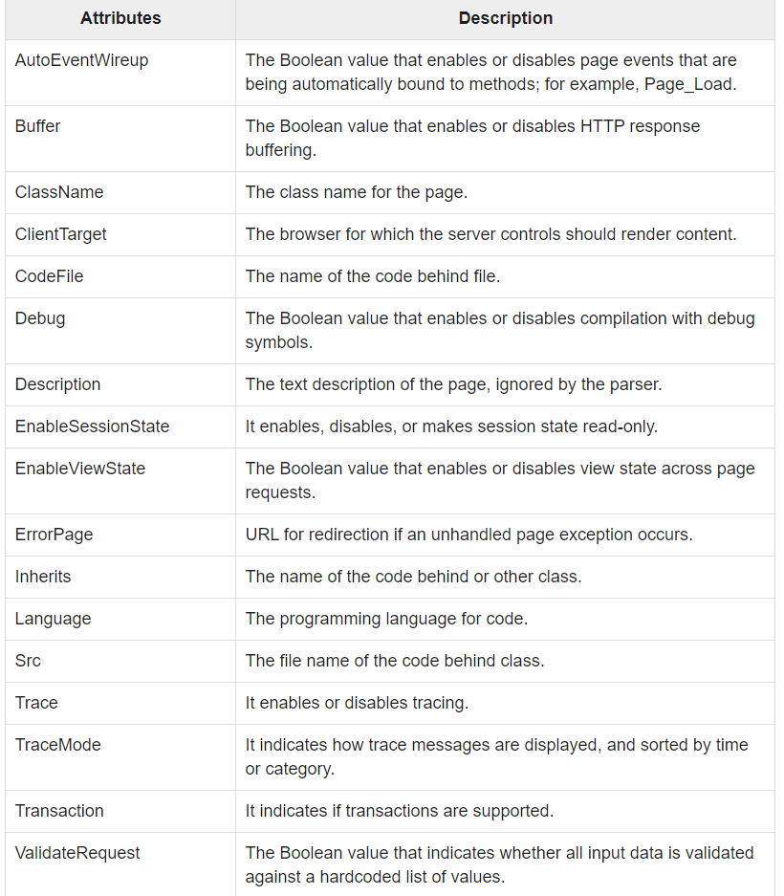
The attributes of the Page directive are:

Slide 23
post-back event
Postback events cause the form to be posted back to the server immediately.
These include click-type events, such as Button. Click.
In contrast, many events, typically change events, are considered non-postback because the event is not posted back to the server immediately.
ispostback=true -page is being loaded in response to a client postback.
ispostback=false -the page is loaded for the first time.
A postback is initiated by the browser, and reloads the whole page, usually when a control on the page (e.g. a button) is changed.

Slide 24
All the web applications are running on Web Servers.
Whenever a user made a request to the web server, the web server has to return the response to the user.
PostBack is the name given to the process of submitting all the information that the user is currently working on and send it all back to the server.
Postback is actually sending all the information from client to web server, then web server process all those contents and returns back to client.
A postback originates from the client side browser.
When the web page and its contents are sent to the web server for processing some information and then, the web server posts the same page back to the client browser.
Normally one of the controls on the page will be manipulated by the user (e.g. button click), and this control will initiate a postback.
Then the state of this control and all other controls on the page is Posted Back to the web server.

Slide 25
The page itself is instantiated as a control object.
All web forms are basically instances of the ASP.NET Page class.
The page class has the following extremely useful properties that correspond to intrinsic objects:
Session
Application
Cache
Request
Response
Server
User
Trace

Slide 26
Server Object
The Server object in Asp.NET is an instance of the System.Web.HttpServerUtility class.
The HttpServerUtility class provides numerous properties and methods to perform various jobs.
Request Object
The request object is an instance of the System.Web.HttpRequest class.
It represents the values and properties of the HTTP request that makes the page loading into the browser.
This object helps in checking some information such as the client browser and cookies.
Response Object
The Response object represents the server's response to the client request.
It is an instance of the System.Web.HttpResponse class.
In ASP.NET, the response object does not play any vital role in sending HTML text to the client, because the server-side controls have nested, object oriented methods for rendering themselves.
However, the HttpResponse object still provides some important functionalities, like the cookie feature and the Redirect() method.
The Response.Redirect() method allows transferring the user to another page, inside as well as outside the application. It requires a round trip.

Slide 27
ASP.NET Web server Controls
Server controls are objects placed on a page with the purpose of read and write data.
A Server Control starts with <asp: followed by the object name <asp:textbox .
They must contain two other properties, ID which must be unique and runat=”server” which tells the web server to give the control server side processing.
<asp:control_name id="some_id" runat="server" />
They can be self closed by having a forward slash (/) before the ending tag or have a closing tag:
<asp:textbox id=”txt” runat=”server” />
<asp:textbox id=”txt” runat=”server” ></asp:textbox>
After a control is processed by the web server, a standard HTML tag is sent to the browser for displaying. The above example will be rendered as:
<input type=”text” name=”txt” id=”txt” />

Slide 28
1. Button <asp:button/>
Post back control for form submission.
Example: <asp:button id=”btn” runat=”server” text=”Search”/>
Properties:
2. Checkbox <asp:checkbox/>
Selection control (multiple selections).
Example: <asp:checkbox id=”ck” runat=”server” text=”Diploma”/>
Properties:
Id=”btn” Runat=”server” Text=”Search” Enabled=”true/false” | Creates an unique identifier Sets the button for server side processing Displays text on the button Enables or Disables the button
Id=”ck” Runat=”server” Text=”Diploma” Checked=”true/false” | Creates an unique identifier Sets the checkbox for server side processing Displays text on checkbox Checks or Uncheck the checkbox

Slide 29
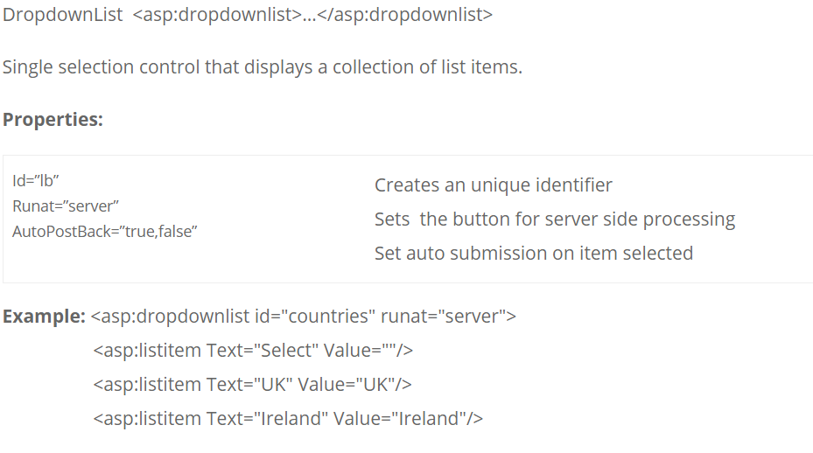
DropdownList <asp:dropdownlist>…</asp:dropdownlist>

Slide 30
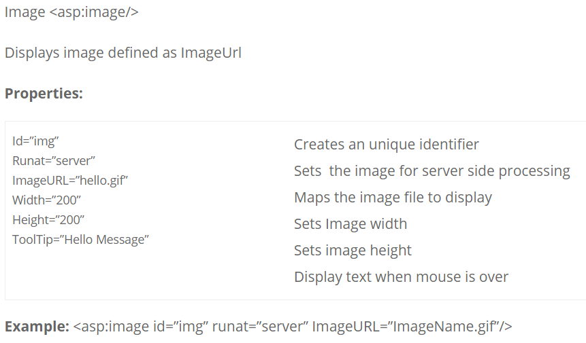

Slide 31
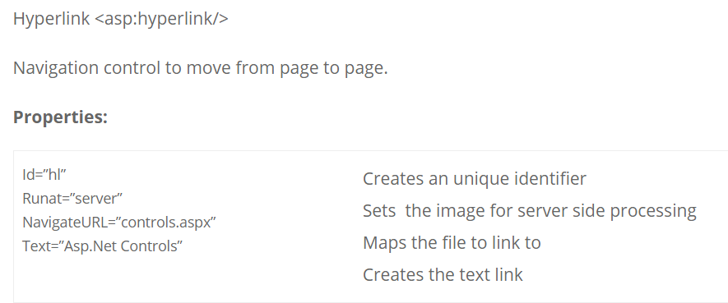
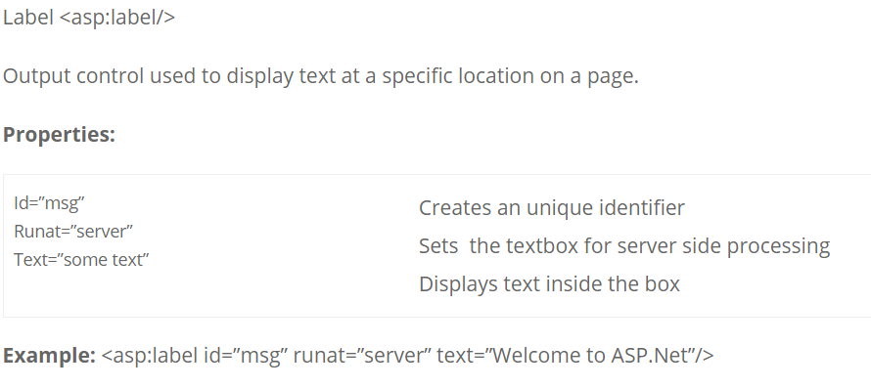

Slide 32
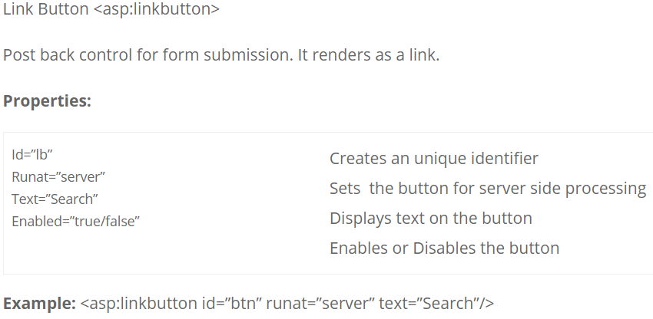

Slide 33
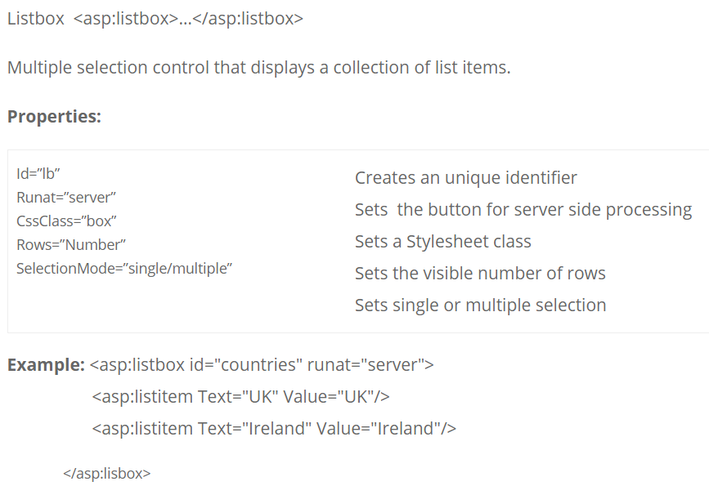

Slide 34
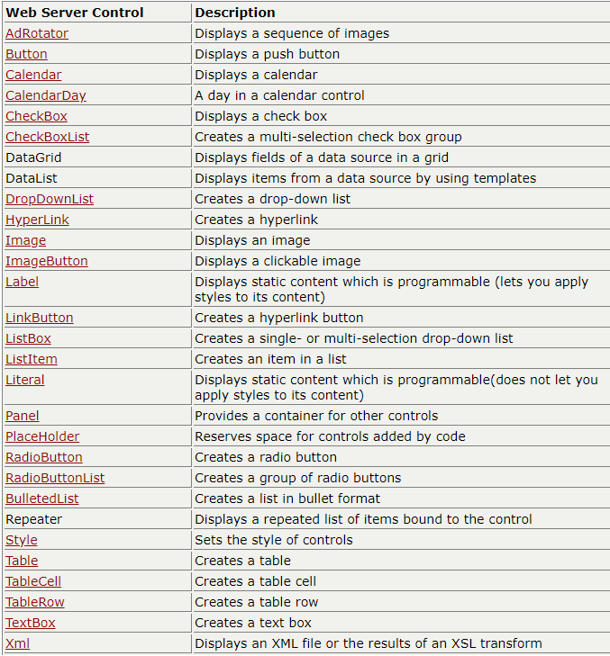

Slide 35
HTML Server Controls
HTML elements in ASP.NET files are, by default, treated as text.
To make these elements programmable, add a runat="server" attribute to the HTML element. This attribute indicates that the element should be treated as a server control.
All HTML server controls must be within a <form> tag with the runat="server" attribute!

Slide 36
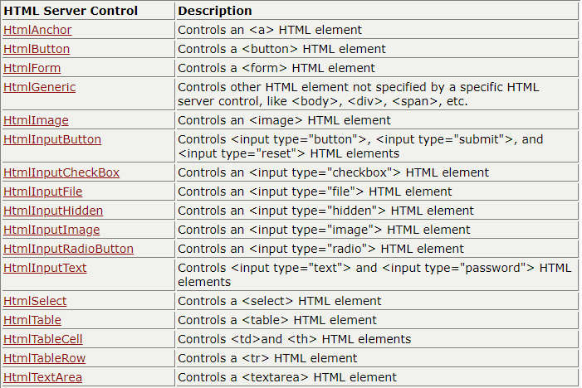

Slide 37
ASP.NET - Event Handling
An event is an action or occurrence such as a mouse click, a key press, mouse movements, or any system-generated notification.
A process communicates through events. For example, interrupts are system-generated events. When events occur, the application should be able to respond to it and manage it.
Events in ASP.NET raised at the client machine, and handled at the server machine.
For example, a user clicks a button displayed in the browser. A Click event is raised. The browser handles this client-side event by posting it to the server.
The server has a subroutine describing what to do when the event is raised; it is called the event-handler.
Therefore, when the event message is transmitted to the server, it checks whether the Click event has an associated event handler.
If it has, the event handler is executed.

Slide 38
Event Arguments
ASP.NET event handlers generally take two parameters and return void. The first parameter represents the object raising the event and the second parameter is event argument.
The general syntax of an event is:
private void EventName (object sender, EventArgs e);
Application and Session Events
The most important application events are:
Application_Start - It is raised when the application/website is started.
Application_End - It is raised when the application/website is stopped.
Similarly, the most used Session events are:
Session_Start - It is raised when a user first requests a page from the application.
Session_End - It is raised when the session ends.

Slide 39
Page and Control Events
Common page and control events are:
DataBinding - It is raised when a control binds to a data source.
Disposed - It is raised when the page or the control is released.
Error - It is a page event, occurs when an unhandled exception is thrown.
Init - It is raised when the page or the control is initialized.
Load - It is raised when the page or a control is loaded.
PreRender - It is raised when the page or the control is to be rendered.
Unload - It is raised when the page or control is unloaded from memory.

Slide 40
To be continued….

